Slide 2
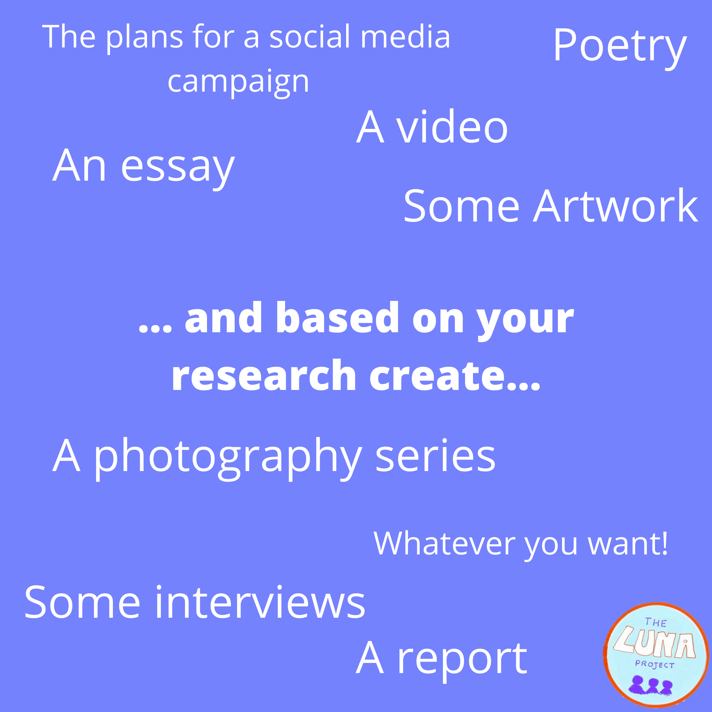
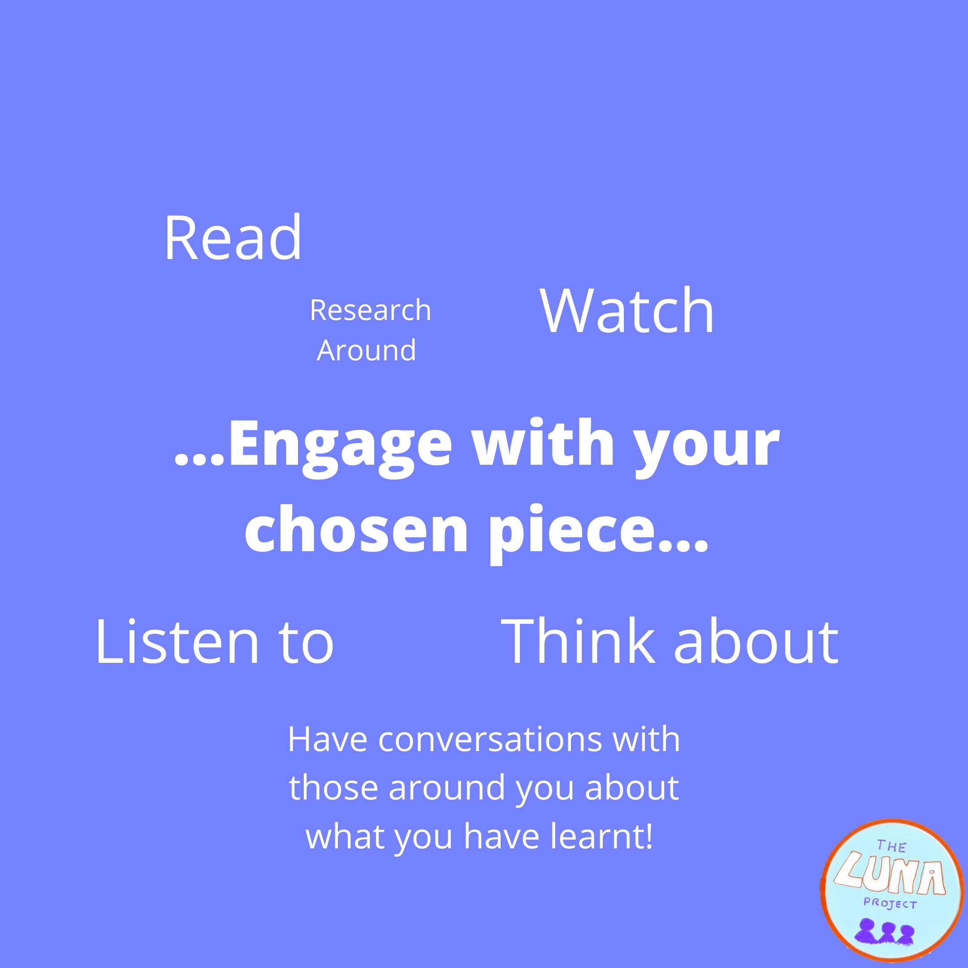

Slide 3
You can listen to the podcast here: https://disabilityvisibilityproject.com/2019/10/20/ep-62-black-disabled-women-in-media/
And you can access the transcript here: https://docs.google.com/document/d/1ZS2_HOrDtb-yBhkoxOBlDPyj2hi5ekR4w4t47eIUOaw/edit

Slide 4
You can watch this on YouTube here: https://www.youtube.com/watch?v=AvGNiwR57iI

Slide 5
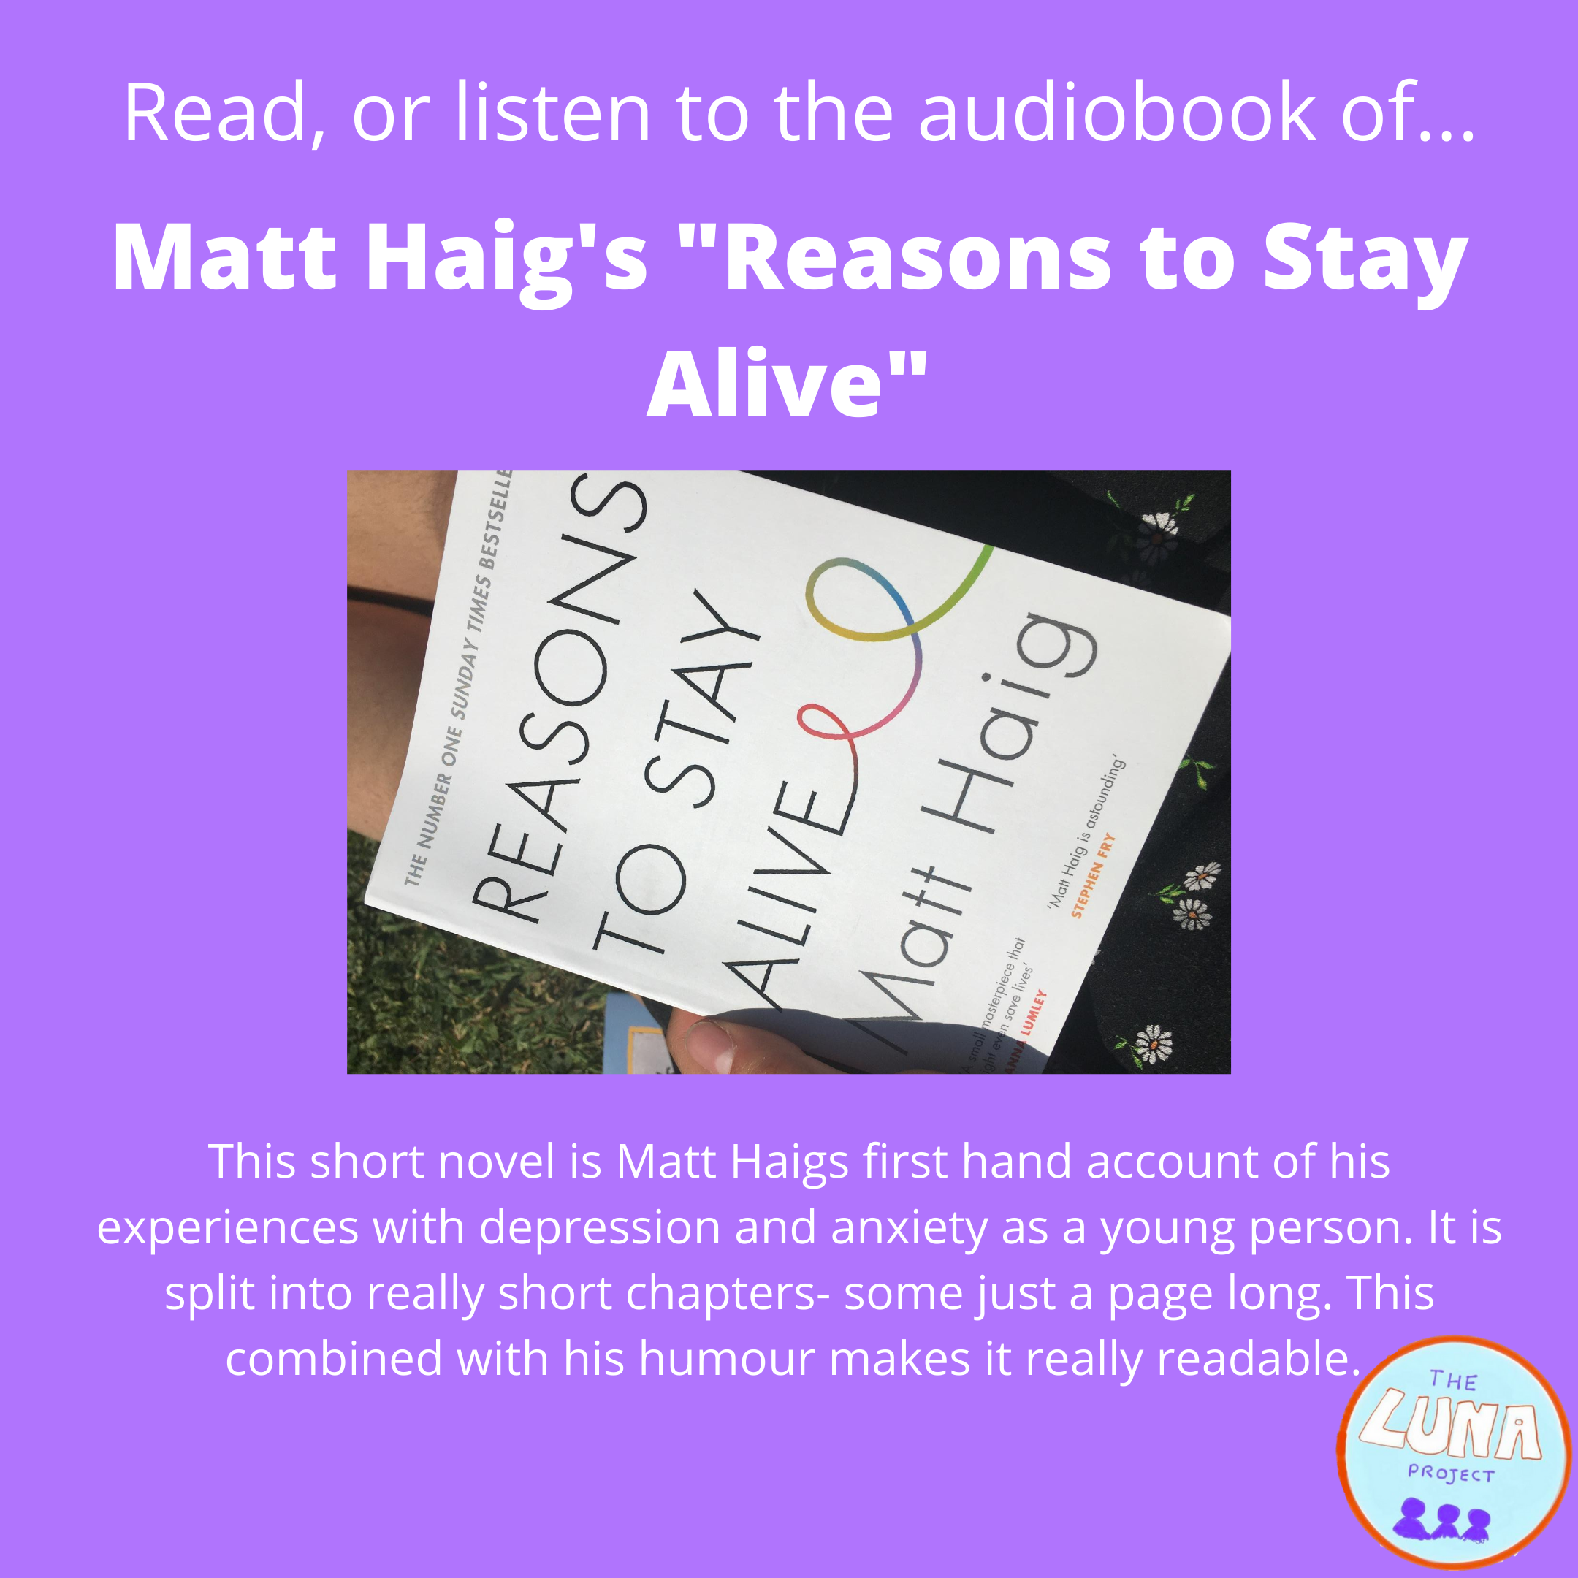
You can borrow this book from our lending library, your school library, local library, or buy it form your local bookstore. You can listen to the audiobook for free as part of your audible free trial!

