Slide 1
Independent LUNA Research Project…

Slide 2
What is it?
Pick the chronic illness/disability/long term health condition you want to look into. We have three suggestions for you, but youre welcome to pick another!
Begin to do some research! We have provided you with some starting points- both in terms of sources, and questions to look into. Let the research go in a direction that interests you!
Present your findings! We have given you suggestions of how you can do this, but as you will see from the diversity of our suggestions, we want you to do this in whatever way suits you!
Share these! Certainly, we would love to see what you come up with (email us at thelunaprojectuk@gmail.com) and we are sure that so would your peers!
So, lets dive in, taking it each of these steps at a time…

Slide 3
Pick a condition…
We give you the suggestions of..
1. Crohn’s Disease
2. OCD
3. Epilepsy
Or, to pick any chronic illness/disability/long term health condition that interests you!
There are “reading lists” for each of these at the end of the power point!

Slide 4
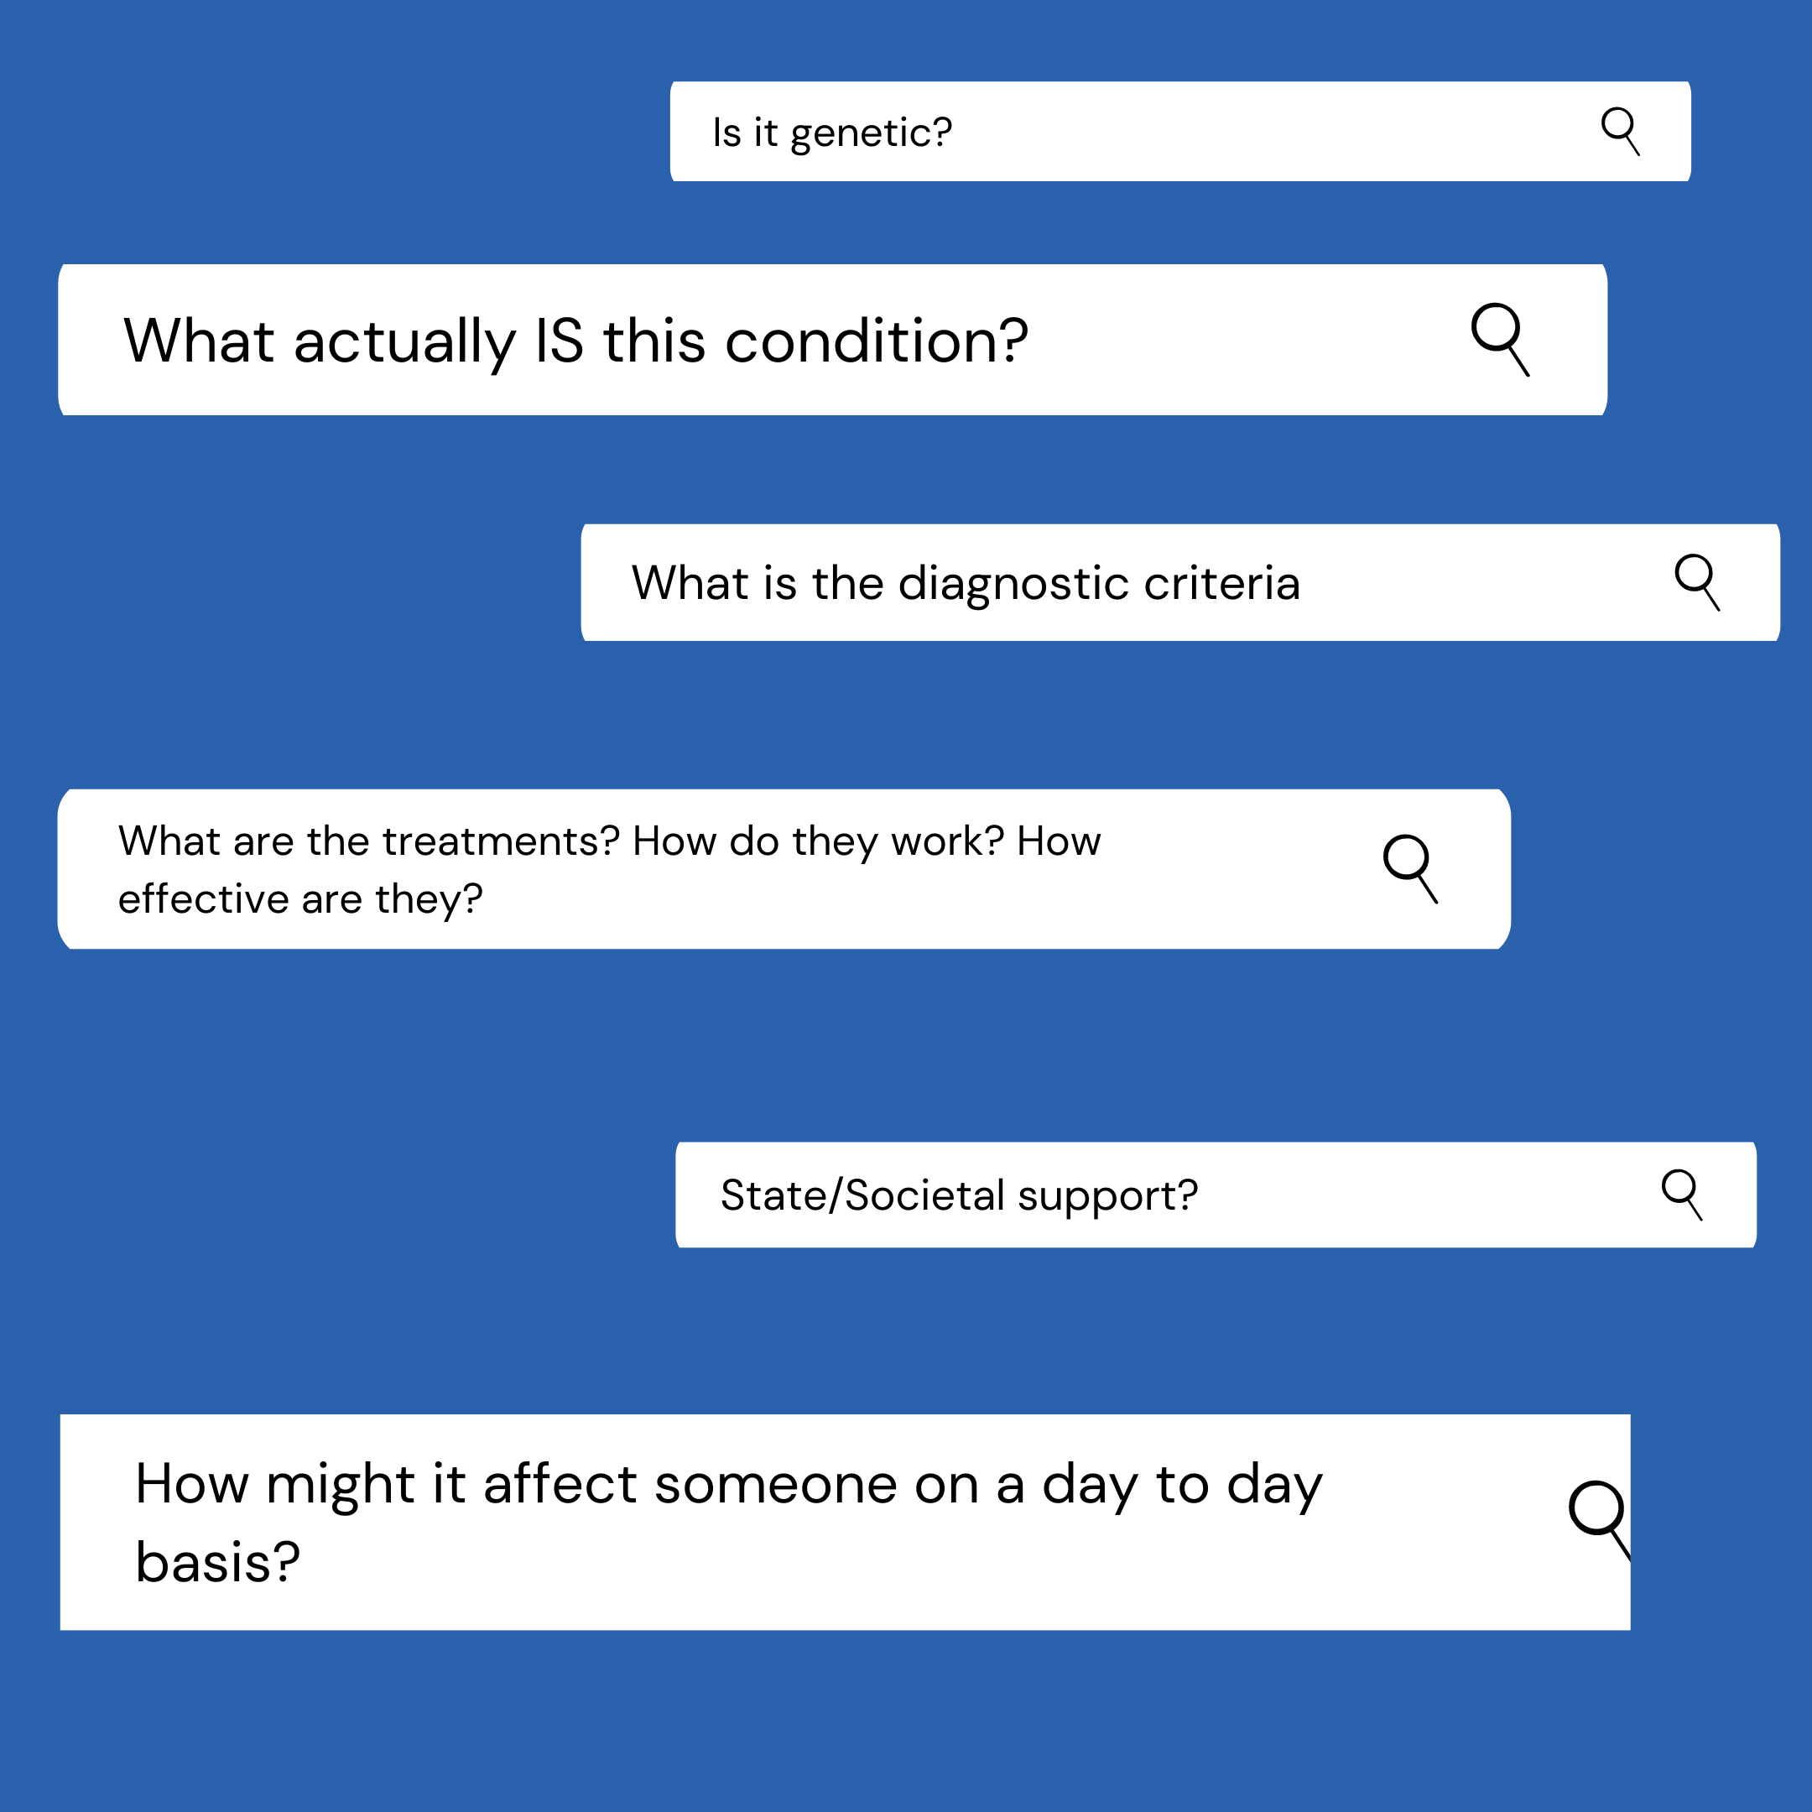
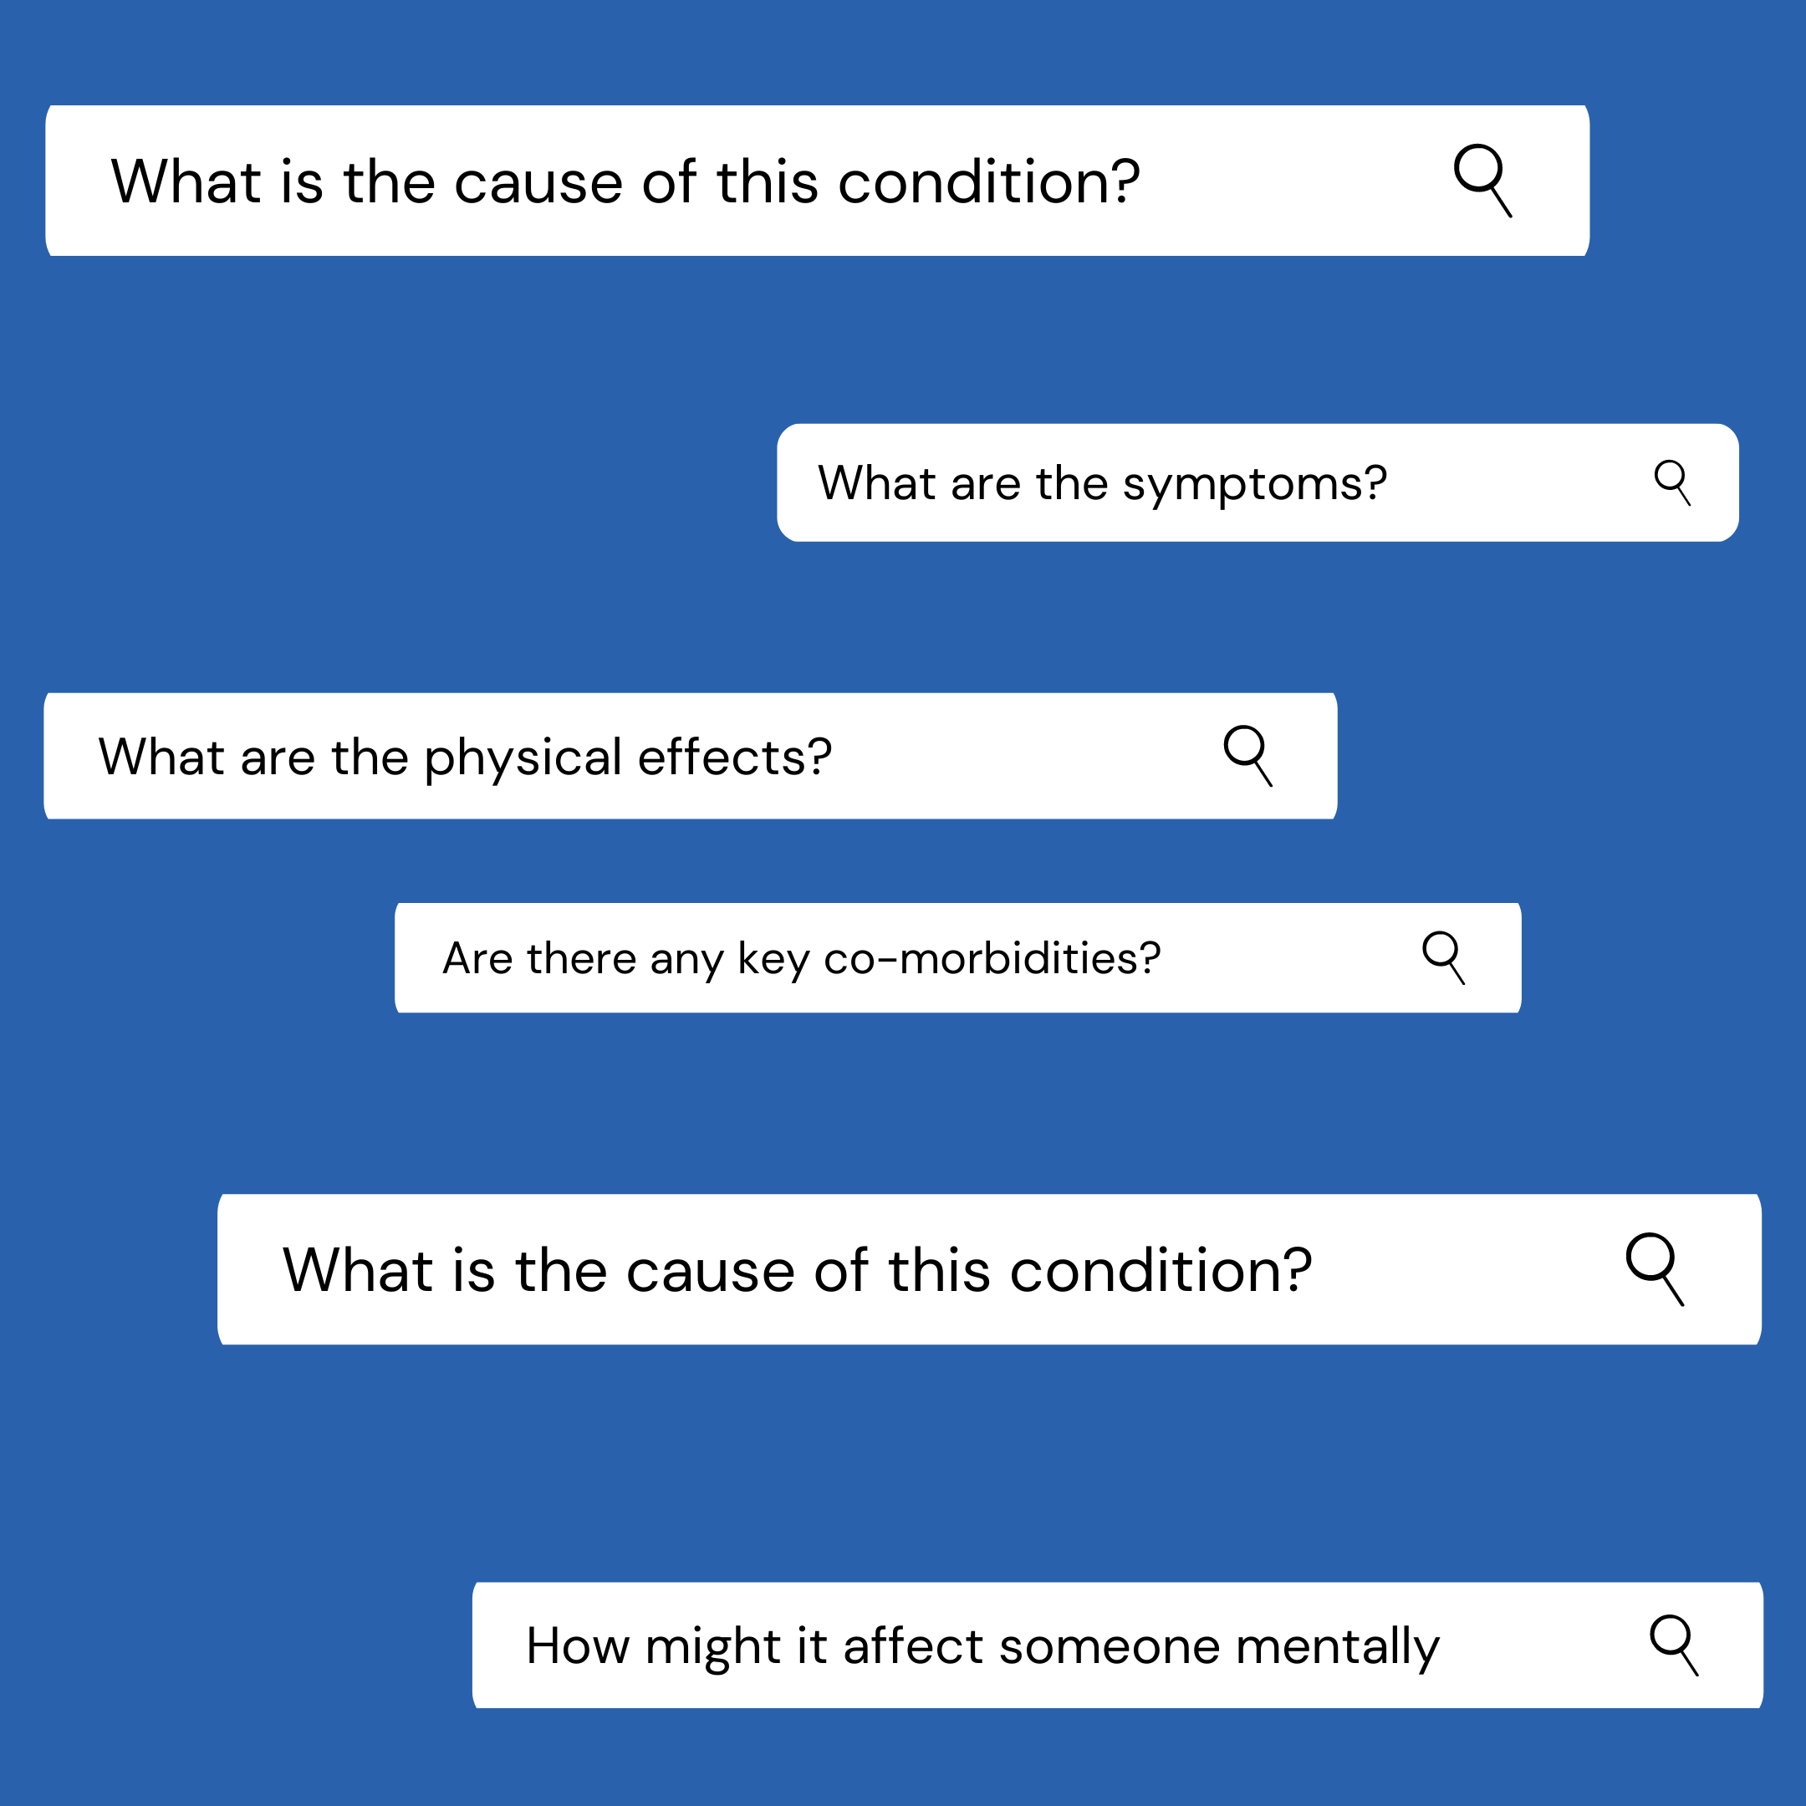
Questions to start your research off with…
We would suggest that you start broad- have a little look into all of them and then work out which aspects interest you, and then really focus in on those.

Slide 5
How should you present you research?
Newspaper Article
Write a report
Scientific Journal Article
Write an Essay
Storyboards
Make an information leaflet
Make a short documentary
Make an explanatory comic strip cartoon
Make a poster
Presentation
… really, however you want!
Make a Fact file

Slide 6
Finally, share what you have created!
Certainly, we would love to see what you come up with (email us at thelunaprojectuk@gmail.com or send them to us on social media) and we are sure that so would your peers!

Slide 7
Suggestion #1: Crohn's Disease:
Some places to start your research…
The UK Charity “Crohn’s and Colitis UK” https://www.crohnsandcolitis.org.uk/. They also have an Instagram @crohnsandcolitisuk. This is great for a general overview and for the people side of things.
The NHS’s information page on Crohn’s Disease https://www.nhs.uk/conditions/crohns-disease/
The site “Osmosis” is geared towards supporting science and healthcare students in understanding different conditions. This is a really good video they have on the scientific side of Crohn’s. https://www.osmosis.org/learn/Crohn's_disease
Here are some of our blog posts that give an insight into what it is like to live with Crohn's…
“Living With Crohn's Disease” by Emma Illingworth http://onestepatatime.family.blog/2020/01/03/living-with-crohns-disease/
“I’m embarrassed” by Ella Crossley http://onestepatatime.family.blog/2020/01/14/i-am-embarrassed/
“IBD: A siblings perspective” by Isobel Crossley http://onestepatatime.family.blog/2020/01/16/ibd-a-siblings-perspective/
“Lockdown Conversations: Ableism, Eating Disorders, and Crohn’s“ by Emma Illingworth http://onestepatatime.family.blog/2020/05/18/lockdown-conversations-ableism-eating-disorders-and-crohns/

Slide 8
Suggestion #2: OCD
Some places to start your research…
https://www.nhs.uk/conditions/obsessive-compulsive-disorder-ocd/
The charity Mind has information on OCD https://www.mind.org.uk/information-support/types-of-mental-health-problems/obsessive-compulsive-disorder-ocd/about-ocd/
The International OCD Foundation Website has lots of good information that is geared towards people living with OCD, families and friends, and professionals. https://iocdf.org/about-ocd/#:~:text=Obsessive%20compulsive%20disorder%20(OCD)%20is,that%20trigger%20intensely%20distressing%20feelings.
The site “Osmosis” is geared towards supporting science and healthcare students in understanding different conditions. This is a fab video of theirs on OCD, that really focuses on the science side of OCD. https://www.youtube.com/watch?v=I8Jofzx_8p4
Some of our blog posts that give an insight into what it’s like to live with…
“Obsessive Compulsive Disorder: Stigma, Embarressment, Shame” By James Adamson http://onestepatatime.family.blog/2020/04/05/obsessive-compulsive-disorder-stigma-embarrassment-shame/

Slide 9
Suggestion #3: Epilepsy
Some places to start your research…
This website breaks down the scientific/medical perspective of epilepsy and seizures well. https://emedicine.medscape.com/article/1184846-overview?fbclid=IwAR2lWjpv-U5dGa813c1Q2rB--AQftxwYzZbYzCKk0L-mWq2EOda7IXKVRuM
This Osmosis video on Epilepsy really dives into the science behind seizures and epilepsy: https://www.osmosis.org/learn/Epilepsy
Here is the NHS overview on Epilepsy: https://www.nhs.uk/conditions/epilepsy/
Here is an epilepsy charities information on epilepsy, designed for people living with epilepsy, and family and friends. https://www.epilepsy.org.uk/info/about
Some of our blog posts that give an insight into what it’s like to live with epilepsy…
“Lost and Gained: Ally”. This writing reflects on the positives and negatives of Ally’s experiences with epilepsy. http://onestepatatime.family.blog/2020/03/26/lost-and-gained-ally/
“Diagnosis: A conversation between friends”. Ally, one of the people in this conversation reflects on their diagnosis experience with epilepsy. http://onestepatatime.family.blog/2020/04/19/diagnosis-experiences-a-conversation-between-friends/
“Living with epilepsy at university” looks at the social and academic impact of having epilepsy as a student. https://glasgowguardian.co.uk/2020/02/28/living-with-epilepsy-at-university/

Slide 10
Suggestion #4: any chronic illness/disability/long-term heath condition that interests you!

