Slide 1
The LUNA Project
Learning and Understanding Needs and Abilities

Slide 2
Disablism
Disablism (aka ableism) can be defined as discriminatory, oppressive, abusive behaviour arising from the belief that disabled people are inferior to others. Disablism refers to prejudice, stereotyping, or "institutional discrimination" against disabled people.
Notes:
Introduce the concept of disablism - highlight that disablism and ableism are often used interchangeably (with disablism the preferred term in the UK), or can refer to discrimination against disabled people for disablism and discrimination in favour of non-disabled people for abelsim.

Slide 3
Let’s take a closer look...
Disablism (aka ableism) can be defined as discriminatory, oppressive, abusive behaviour arising from the belief that disabled people are inferior to others. Disablism refers to prejudice, stereotyping, or "institutional discrimination" against disabled people.
Notes:
Let’s take a closer look at this definition of disablism and think about some of the words included.

Slide 4
Discriminatory: treating a person or group differently from and usually worse than other people, because of their skin colour, sex, sexuality, disability etc.
An example would be refusing to be friends with anyone who uses a walking stick, because of them using a walking stick.
“…discriminatory, oppressive, abusive behaviour…”
Oppressive: cruel and unfair treatment
An example would be a sports club at school refusing to allow a wheelchair user to participate.
Try to think of a definition for each of these words and an example (in the context of disablism) in how each could present in real life.
Notes:
On click 1 only the left hand side text will show. Try to think of a definition for the words discriminatory, oppressive, and abusive. Try to think of an example for each of these words. Pause for thinking/suggestions.
On click 2 the Discriminatory text will show.
On click 3 the Oppressive text will show.
Click to the next slide for Abusive.

Slide 5
Abusive: using rude and offensive words or treating someone badly or cruelly, especially physically.
An example would be calling a disabled person rude names (slurs) because of their disability.
“…discriminatory, oppressive, abusive behaviour…”
This behaviour arises from the belief that disabled people are inferior to non-disabled people.
Try to think of a definition for each of these words and an example (in the context of disablism) for each.
Notes:
Discriminatory, oppressive, and abusive behaviour arise from the belief that disabled people are inferior to others

Slide 6
Let’s take a closer look...
Disablism (aka ableism) can be defined as discriminatory, oppressive, abusive behaviour arising from the belief that disabled people are inferior to others. Disablism refers to prejudice, stereotyping, or "institutional discrimination" against disabled people.
Notes:
Let’s take a closer look at this definition of disablism and think about some of the words included.

Slide 7
Prejudice: an unfair and unreasonable opinion or feeling, especially when formed without enough thought or knowledge.
An example is assuming that all people with disabilities need a carer.
“...prejudice, stereotyping, or "institutional discrimination" …”
Stereotyping: to have a set idea about what a particular type of person is like, especially an idea that is wrong.
An example is that all disabled people want to be cured. Stereotypes can be used to justify disablism and reinforce discriminatory behaviours.
Try to think of a definition for each of these words and an example (in the context of disablism) in how each could present in real life.
Notes:
On click 1 the left hand side text will show. Pause for thinking.
Take suggestions for Prejudice. On click 2, prejudice should show.
Take suggestions for Stereotyping. On click 3 Stereotyping will show.
Click to the next slide for institutional discrimination.

Slide 8
Institutional discrimination: The idea that one group is better than another gets rooted in the institutions—the laws, legal system, police, education/schools, hiring, housing, media images, political power—so that they implement discriminatory or unequal practices.
“...prejudice, stereotyping, or "institutional discrimination" …”
An example is that movies often show villains as having a disability. E.g. in ‘Pirates of the Caribbean’ the ‘bad’ pirates often have hooks for hands or wooden pegs for legs (therefore portrayed with a disability), whereas the ‘good’ pirates do not.
Another example would be lack of accessible entrances (e.g. ramps) to shops.
Try to think of a definition for each of these words and an example (in the context of disablism) in how each could present in real life.

Slide 9
Disablism can result in bias against people with disabilities. This means being prejudiced in favour of those without disabilities which means you are more likely to view someone with a disability negatively. Bias can be conscious (aka explicit bias) or unconscious (aka implicit bias).
In conscious bias, people intentionally display negative behaviour against a group in society.
E.g. Rachel refuses to work with Abby, who has epilepsy, on a school project as Rachel thinks Abby will not work as hard.
In unconscious bias, people can display negative behaviour against a group in society without realising.
E.g. Adam is partnered with Greg for a school project. Greg has arthritis so Adam offers to do all the work for Greg as Adam thinks Greg will be unable to do it himself.
Notes:
First of all, we have one about epilepsy…
https://www.youtube.com/watch?v=tA-Bikjbka4
Now we have one about Ulcerative Colitis, (LOOKING FOR A MORE PS ONE!) …
https://www.youtube.com/watch?v=TG4srmK_WDU

Slide 10
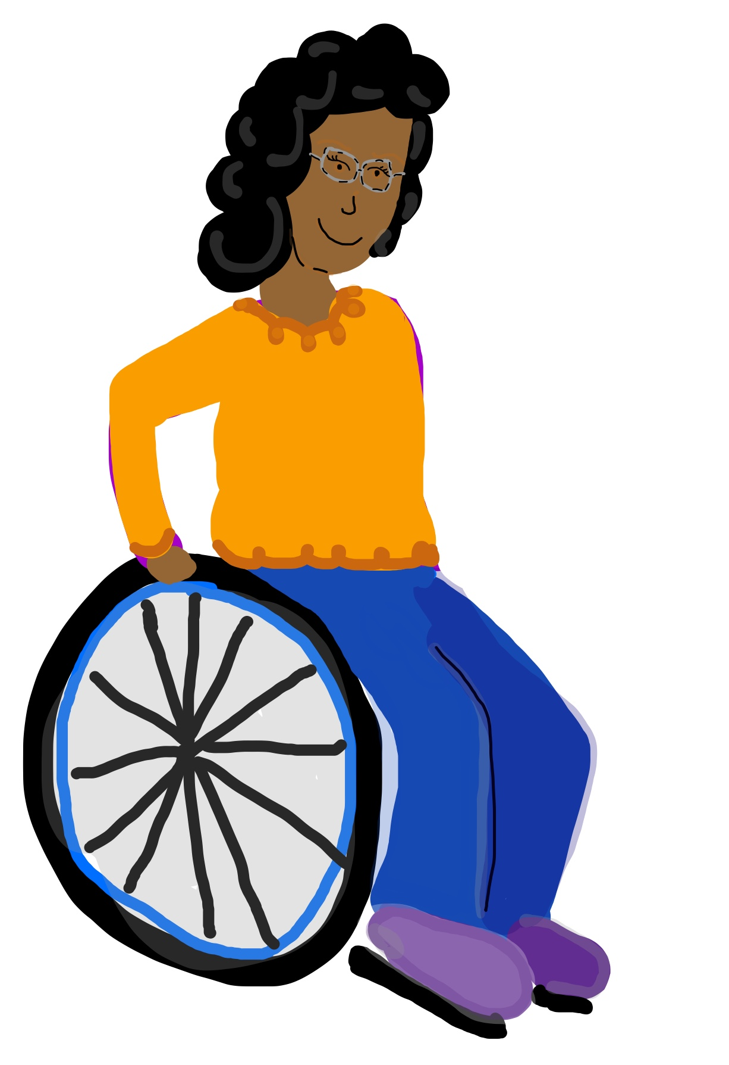
This is Sophie! There are 8 True or False statements below, take a minute to think about these statements and write down your answers somewhere.
Sophie works in a coffee shop.
Sophie has two children.
Sophie went to university and studied Sports Science.
Sophie requires a carer to help her out at home.
Sophie cannot walk.
Sophie is applying for jobs to teach P.E.
Sophie is married.
Sophie’s favourite pastime is reading.
Notes:
https://www.youtube.com/watch?v=E67Z6UER_Dc
Read out slide with a short pause (like a few seconds) between statements. Ask if people are ready to move on (there will be more time for thinking on the next slide but the statements will not be visible)

Slide 11
Look at your answers, why did you answer the way you did? Was it easy or hard to think of answers? Were some statements easier than others?
We will go through the answers on the next slide...

Slide 12
“I don’t know!”
Exercises like these can help to show our unconscious bias as the answers for all of these should have been “I don’t know!”.
Having unconscious biases:
Can lead us to make assumptions about people based on how they look or their identity.
Is normal, i.e. does not make you a bad person!
Can conflict with our conscious values.
Can make us do harmful things while aspiring to do good.

Slide 13
Adam is partnered with Greg for a school project. Greg has arthritis so Adam offers to do all the work for Greg as Adam thinks Greg will be unable to do it himself.
This is an example of unconscious bias. Adam thinks he is helping Greg out by doing his work for him, but Adam has assumed Greg cannot work due to his disability and failed to ask Greg how he could best help him.
Instead if you were Adam try asking Greg about how to help him. This allows Greg to set out his boundaries and explain if he needs help and how best to help him

Slide 14
Unconscious Bias can lead to Micro Aggressions.
Micro-aggressions an example of how unconscious bias can present. Microaggressions are small acts or remarks that makes someone feel insulted or treated badly because of their disability. Microaggressions can also apply to race, religion, sexuality etc. Often microaggressions are not intended to be harmful.
Can you think of any examples? We will look at some on the next side...

Slide 15
Yasmin tells her friend, Abdullah, that she has Crohn’s disease - form of Inflammatory Bowel Disease (IBD) - that means she is chronically ill and has to take medicine every day. Abdullah exclaims that Yasmin is “too young to have a disability!” and “doesn’t look disabled”.
Abdullah’s comments are an example of microaggressions, which are an example of how unconscious bias can present. Microaggressions are small acts or remarks that makes someone feel insulted or treated badly because of their disability. Microaggressions can also apply to race, religion, sexuality etc. Often microaggressions are not intended to be harmful. Can you think of any other examples?

Slide 16
What can you do?
Take the Implicit Association Test online.
Speak up when you see actions that could be the result of unconscious bias.
Next time you assume something about somebody due to how they look or identify, ask yourself why you think that and challenge your beliefs.
Try to think about a recent interaction with someone who was ‘different’ from you, did you assume anything about them because of these differences?
Think of disability, race, religion, gender, sexuality etc.
Be aware of common microaggressions and call them out when you see/hear them!
Don’t be afraid to ask questions!

Slide 17
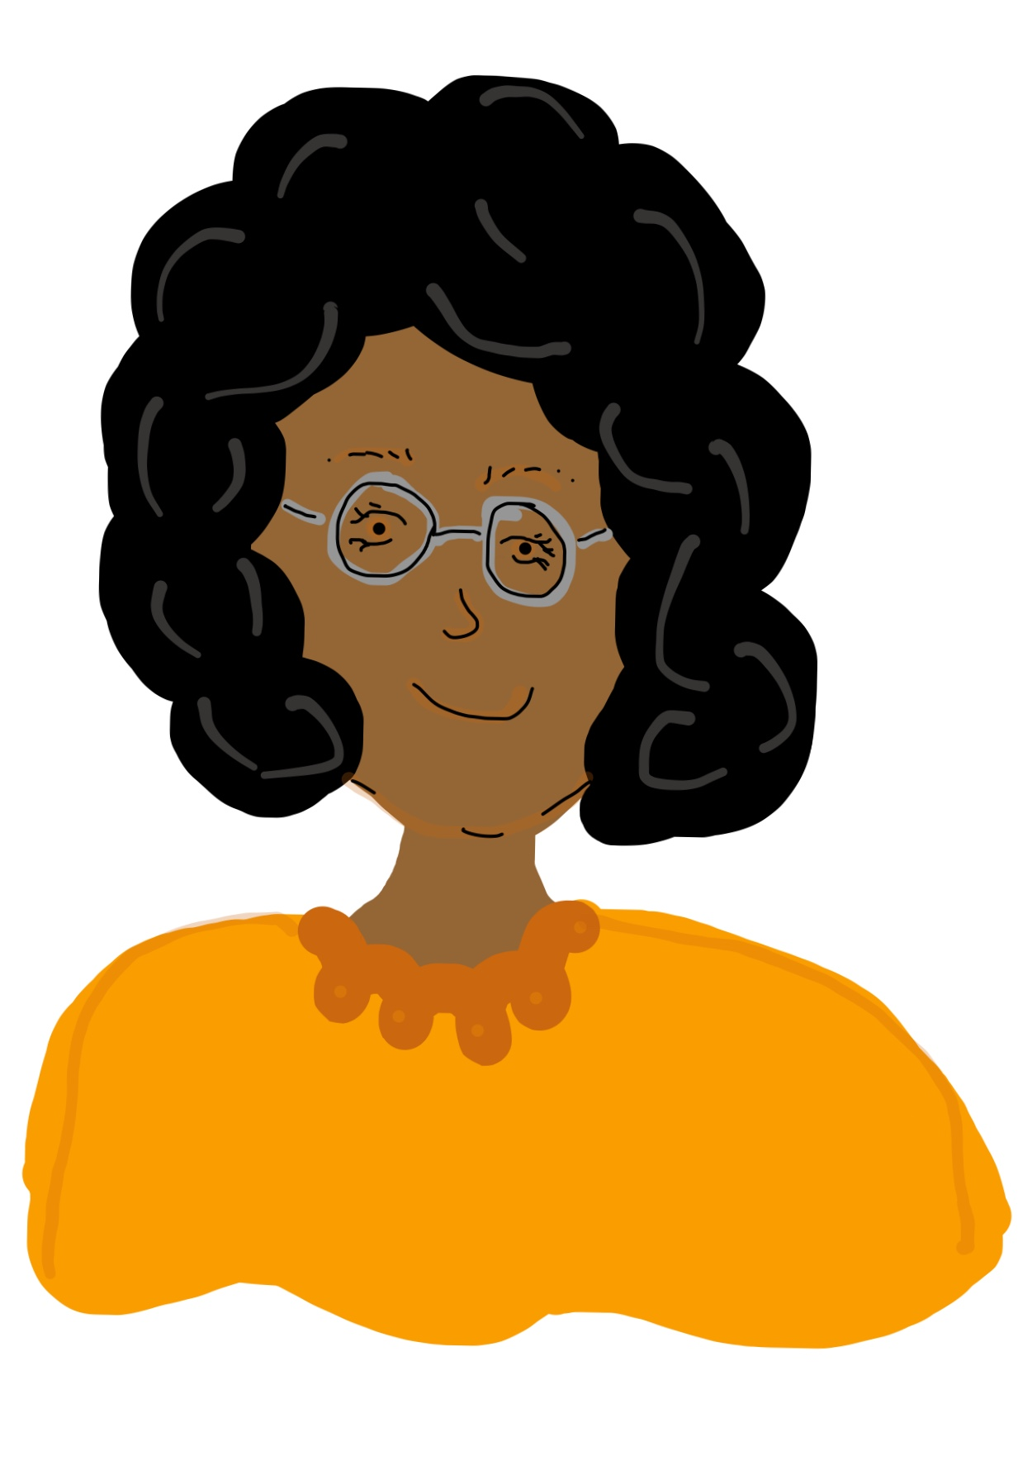
Holding unconscious bias does not make you a ‘bad person’. Unconscious bias is normal and develops largely during childhood through exposure to many things such as to media and family and friends.
Remember!
However, it is important we dig deep and try to recognise false beliefs about disabled people that we may hold so we can actively combat these beliefs and work to undo them before they can cause further harm.

Slide 18
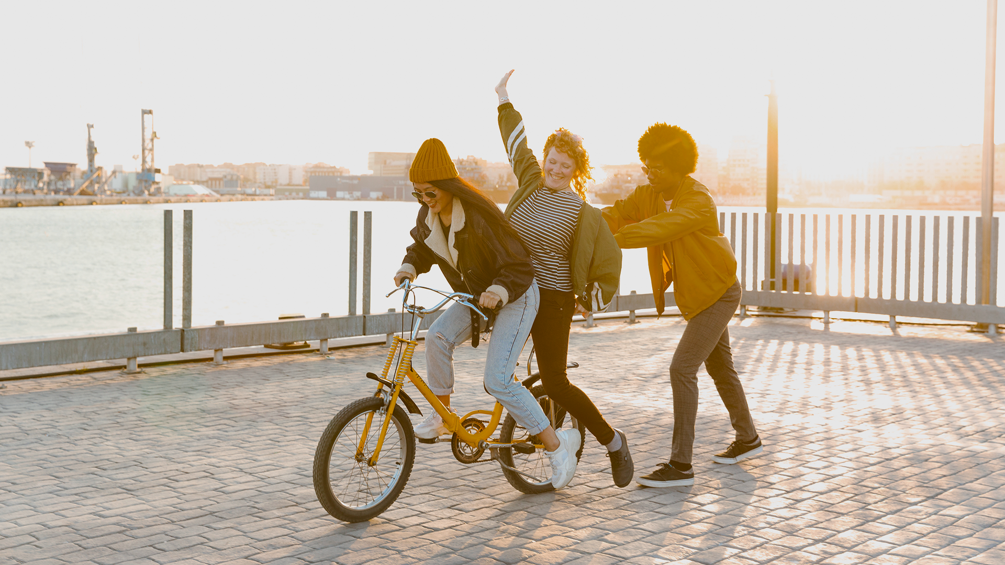
Thank you!
We would to hear what you think… Follow us on social media
FB - The LUNA Project
Instagram - @thelunaprojectuk
Email - thelunaprojectuk@gmail.com

