Slide 1
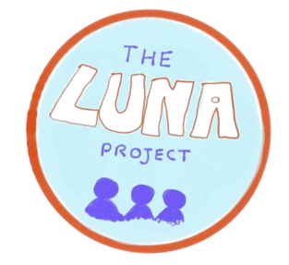
THE LUNA PROJECT PRESENTS
ADVOCACY, ALLYSHIP AND THE DISABLED COMMUNITY
An online learning resource

Slide 2
LEARNING OUTCOMES
By the end of this workshop:
I will have learnt about the concepts of ableism and disablism
I will have thought about the impact this has on the disabled community
I will understand the difference between different models of disability, and how these can affect the disabled community
I will have learnt about the concepts of allyship and advocacy, and why these are important
I will have thought of ways in which I can be an effective ally to the disabled community, and ways in which I can advocate for positive change

Slide 3
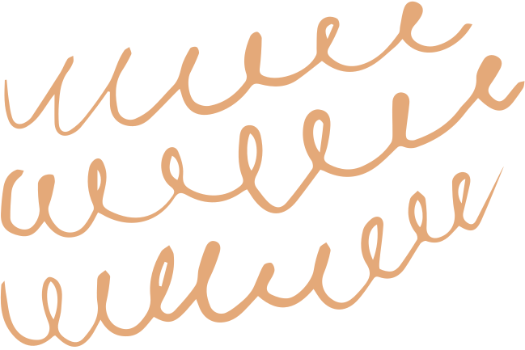
Ableism vs Disablism

Slide 4
WHAT IS THE DIFFERENCE?
What are your ideas?
Take a minute to brainstorm and gather your thoughts on what these terms are and what they mean. Don't worry if you aren't sure!

Slide 5
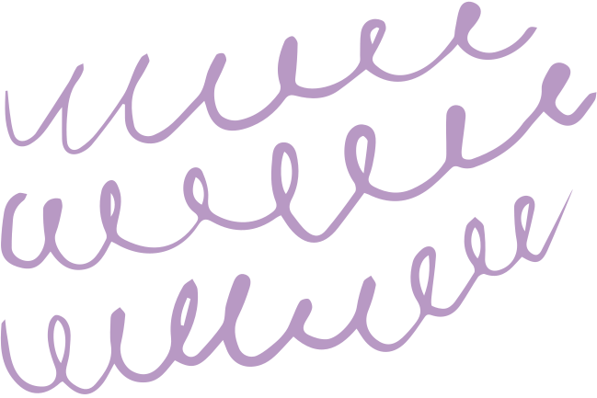
Ableism
Disablism
Discrimination in favour of non-disabled people
Discrimination against disabled people
Image descriptions: (Left) Some children in colourful clothes standing and laughing together.
(Right) A young girl in colourful clothing using crutches.

Slide 6
WHY THE DISTINCTION?
EMPHASIS ON TYPE OF DISCRIMINATION
There is a subtle difference between the types of discrimination here - one is positive discrimination in favour of one group, and the other is negative discrimination against another.
MODELS OF DISABILITY
The use of the term "ableism" to describe discrimination against disabled people can imply that the discrimination is related to the person's ability, as implied by the medical model of disability. However, "disablism" reflects the social model of disability - a person is disabled (and thus faces this discrimination) because of societal barriers, not because of their level of ability.
Whilst these terms do have a slightly different meaning, they can be used interchangeably - neither is "wrong" to say! Generally, in the UK the preferred term is disablism.

Slide 7
Discrimination
Discrimination against disabled people means treating them differently, usually inferiorly, on account of their being disabled. Discrimination can be on an individual level or institutional - institutional discrimination is particularly dangerous as it ingrains the idea that disabled people are somehow "lesser" in society.
Disablist behaviours can take many forms
Oppression
Disabled people are often treated unfairly and cruelly in society, for example being denied an opportunity to participate in something on account of their disability.
Abuse
Abuse against disabled people can take many forms, from the use of offensive slurs to physical abuse. Around 1 in 7 disabled adults aged 16 to 59 years in the UK experienced domestic abuse in the year ending March 2019, almost three times higher than non-disabled people. (Source: ONS Disability and crime, UK: 2019)
Prejudice
Prejudices are judgements made without thought or knowledge, usually based on (often harmful) stereotypes. This reinforces disablist behaviour in a vicious circle, and can be used in an attempt to justify disablism.

Slide 8
WHAT IS THE IMPACT?
Think of some examples of ableism/disablism. What would the impact of this on a disabled person be? How would they feel?
Come up with some examples of ableism/disablism and complete an empathy map for a disabled person facing these situations. The empathy map can be found in this section of the website.

Slide 9
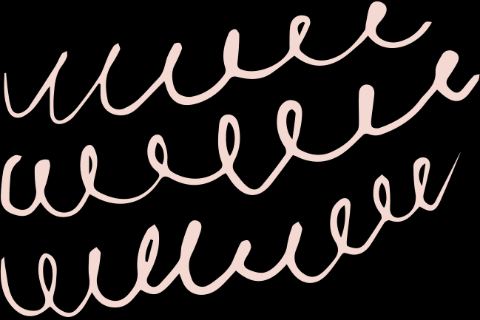
32%
OF DISABLED PEOPLE BELIEVE THAT THERE IS A LOT OF PREJUDICE AGAINST DISABLED PEOPLE
WHILST ONLY
22%
OF NON-DISABLED PEOPLE BELIEVE THE SAME
SOURCE: SCOPE - DISABILITY PERCEPTION GAP (2018)

Slide 10
MODELS OF DISABILITY

Slide 11
There are many different models of disability (you can learn more with some of the links at the end of this workshop), but we are going to focus on two in particular:
Medical model of disability
Social model of disability
A person is disabled by their differences
A person is disabled by societal barriers
Image descriptions: (Left) A person in a grey shirt using a wheelchair, facing away from the camera.
(Right) A staircase.

Slide 12
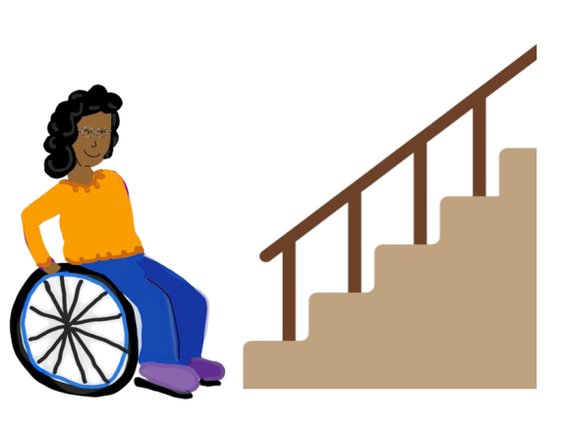
Medical model
Social model
The problem is that she is in a wheelchair. We should fix this by curing her.
The problem is the stairs. We should fix this by building a ramp.
Image description: A cartoon drawing of a woman in a wheelchair beside a set of stairs.

Slide 13
MEDICAL MODEL OF DISABILITY
The medical model of disability is generally considered to be negative by the disabled community.
RESOURCES
SELF-IMAGE
STIGMA
The medical model places emphasis on cures, testing and other exclusively medical interventions. This money could instead be spent on making accommodations for disabled people, rather than trying to "fix" them.
The focus on the disabled person's differences can lead to a negative self-image and cause people to think that the challenges they face are because their bodies are not "normal".
The medical model promotes a largely negative and disempowered image of the disabled community - this further oppresses disabled people and makes society less likely to question or challenge their exclusion.

Slide 14
Social Model of Disability
The social model of disability is generally considered to be more positive by the disabled community. However, not everyone uses it - always remember that the way an individual chooses to describe their disability and identity is up to them.
DISTINCTION
CREATED BY DISABLED PEOPLE
RECOGNITION
PERCEPTION
The social model makes an important distinction between impairment and disability, emphasising that it is the barriers in society which disable someone.
The social model was originally developed by disabled people, meaning that it may better represent their experiences and feelings.
Emphasising that societal barriers are what disables people allows non-disabled people to recognise this, and in turn to better accommodate disabled people.
The social model can help to change non-disabled people's perspective on disability as a whole, helping to challenge stereotypes and break down harmful stigma surrounding disability.

Slide 15
WHAT IS THE IMPACT?
Think about the positive and negative associations of both models (you can do some more research using the links at the end of this workshop). What effect do these associations have on the disabled community?
Write down your thoughts on this. If you are in a group, you can discuss amongst yourselves. Which model do you think is the most accurate and positive for the disabled community? You can create empathy maps for how a disabled person might feel about each of these models.

Slide 16
ALLYSHIP AND ADVOCACY

Slide 17
Allyship
Advocacy
Building relationships based on trust, consistency, and accountability with a marginalised group, e.g. the disabled community
Publicly supporting and fighting for a particular cause, e.g. disability rights
Image descriptions: (Left) A wheelchair user with long hair is laughing and talking with two people standing facing away from the camera in a busy room.
(Right) A group of people, some of whom are wheelchair users, wearing purple shirts holding signs with the slogan "#StandByMe" at a rally which took place in New South Wales, Australia.

Slide 18
WHY IS THIS IMPORTANT?
USING YOUR PRIVILEGE FOR GOOD
A non-disabled person has inherent privilege compared to a disabled person. This doesn't mean that a non-disabled person cannot face challenges or discrimination - it simply means that a disability is not one of the things making their life harder. As an ally, you can use this privilege to bring attention to the experiences of the disabled community and amplify their voices.
SUPPORTING THE DISABLED COMMUNITY
All too often, the voices of the disabled community go unheard. You can help support disabled people to feel able to express their concerns, thoughts and opinions, and listen to what they have to say. Campaigning with the disabled community on the issues that matter to them is key in being an ally and advocate.
There are many reasons why allyship and advocacy are important, this is just scratching the surface. Have a think about reasons why these concepts matter so much. If you are in a group, you can discuss this amongst yourselves.

Slide 19
PRACTICE ACCOUNTABILITY
Mistakes happen! Own up to your mistakes when they happen, and take on board feedback so you can be better in the future.
TIPS ON BEING A GOOD ALLY
EDUCATE YOURSELF
Learn about the issues affecting the community - the best way to do this is to listen to disabled people! Actively seek out disabled voices and experiences, learn from them, and promote them to others.
PROMOTE ACCESSIBILITY
This list is far from exhaustive! You can do some more research with the links at the end of this workshop. If you are in a group, discuss ways in which you think you can be a good ally to the disabled community.
Challenge inaccessibility when you see it. If you are in control of a space, such as your social media, work to make it accessible (for example, by including image descriptions).
BE RESPECTFUL
Don't define disabled people by their disability. Use the language that people ask you to use.

Slide 20
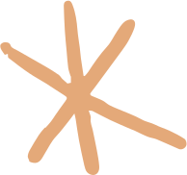
ROUND-UP
What have you learnt today?
Take some time to think about the concepts we have covered today and the ways in which they all link together. Has your understanding of disablism and the different models of disability improved? How will this understanding help you to be a better ally. Write down your thoughts and, if you are in a group, discuss what you have learnt.

Slide 21
FURTHER READING
Use these links to learn more about the topics covered in this workshop. These are just starting points - look for further information elsewhere!
https://www.scope.org.uk/about-us/disablism/
https://stillmyrevolution.org/2013/01/01/disablism-or-ableism/
https://www.coe.int/en/web/compass/disability-and-disablism
https://medicalxpress.com/news/2012-07-disablism-future-young-people-disability.html
https://www.choiceforum.org/docs/disablistbritain.pdf
https://www.scope.org.uk/media/disability-facts-figures/
https://www.scope.org.uk/campaigns/disability-perception-gap/

Slide 22
FURTHER READING (Cont.)
https://now.aapmr.org/conceptual-models-of-disability/
https://www.disabled-world.com/definitions/disability-models.php
https://www.scope.org.uk/about-us/social-model-of-disability/
https://www.devon.gov.uk/equality/communities/disability
https://www.achieveability.org.uk/main/policy/social-model-of-disability
https://womenscaucus.co.uk/2019/11/11/top-5-tips-for-being-a-good-disability-ally/
https://www.communitybusiness.org/latest-news-publications/role-allyship-forging-diverse-and-inclusive-workplaces
https://worldrenew.net/blog/why-advocacy-important

Slide 23
THE LUNA PROJECT PRESENTS
ADVOCACY, ALLYSHIP AND THE DISABLED COMMUNITY
We would love to see any of the work you have produced for this workshop! Please tag us on social media or email us at thelunaprojectuk@gmail.com - we may even ask to publish it (with credit and permission) on our website!

