Slide 1
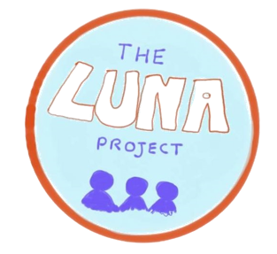
The
Presents..
LUNA Project
Disability Superheroes
Smack
An Online Learning resource

Slide 2
Learning Outcomes
By the end of this workshop:
I will have learnt about some famous superheroes with disabilities
I will know what representation means and why it is important
I will have designed my own superhero with a disability
I will have made a comic strip with my character
I will have thought about ways that I can be a Disability Superhero

Slide 3
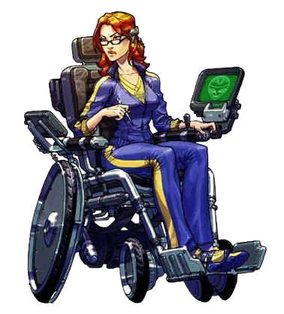
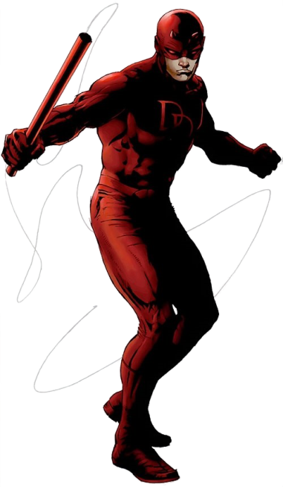
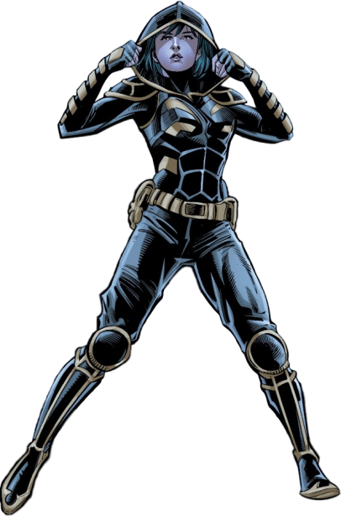
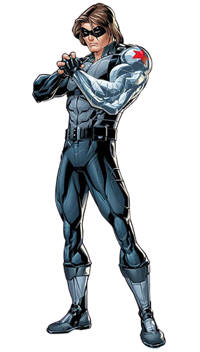
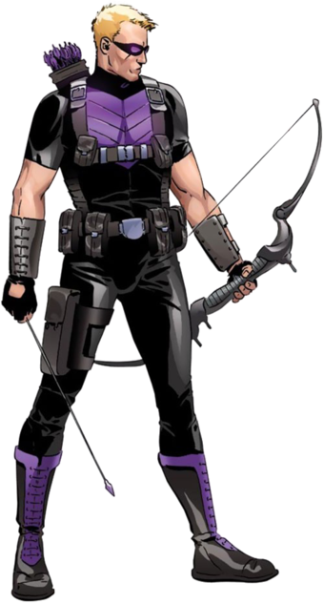
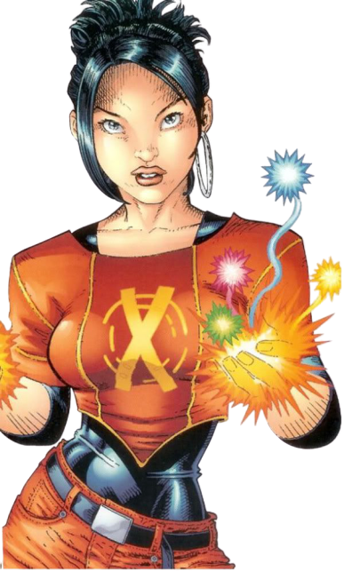
Superheroes with Disabilities
Lots of famous superheroes have disabilities or long-term health conditions!
Look through the factfiles that come with this workshop to learn more about some superheroes who have disabilities
Have a think about how these characters help people to understand their disabilities

Slide 4
Representation
Representation is the way a particular group of people are shown in media such as books, television and films
Characters with disabilities or long-term health conditions are representation for people who have disabilities
Good representation is important because it can influence how people think about disability. It also educates people who don’t have disabilities on what it is like to have that disability
It is also important because it lets people with health conditions see someone like them in their favourite tv show, book or movie
Good representation matters because it shows people that disability is not a bad thing and should not hold people back!

Slide 5
TASK
You are going to design a brand-new superhero with a disability!
Use the blank factfile to create your character – you can use the other factfiles as inspiration to get you started
Do some research on your character’s condition so that you can tell us about how they will teach other people about it. you can pick one of the conditions the superheroes in the factfiles have, or you can choose a different one – the important part is for you to understand and represent the condition your character will have!

Slide 6
Your Superhero
Now that you have created your very own superhero, it’s time to put them in action!
There are templates for a storyboard and comic strip that come with this workshop – use these to create a short comic all about your superhero!
Use your storyboard to plan an adventure for your character and create it in the comic strip
Your comic should teach at least one thing about the condition your character has – for example, if your character is deaf, maybe you can show them using sign language
Have fun!

Slide 7
Being a Disability Superhero
Superheroes are always fighting for the right thing – we want you to become Disability Superheroes!
How can you be a better friend to people with disabilities? What can you do to help them?
Use the mindmap included with this workshop to brainstorm ways that you can be a Disability Superhero in your everyday life

Slide 8
Examples
I can offer to help push my friend in a wheelchair up a hill
I can help my friend catch up on work they have missed when they were off sick
I can be a
good listener
I can learn about different conditions so that I can support the people who have them
I can describe things for my friend who can’t see or hear them well
I can correct someone who has made a wrong assumption about disability

Slide 9
Today we have learnt
We have learnt about some famous superheroes who have disabilities and long-term health conditions
We have learnt what representation is and why it is important
We have designed a new superhero with a disability and learnt about their condition
We have created a comic strip with our new superheroes that teaches about their disabilities
We have thought of ways to be Disability Superheroes in our everyday lives

Slide 10
Well done!
Content ©The LUNA Project 2020. Powerpoint template from slidebazaar.com. Superhero images ©DC Comics and ©Marvel Comics.
Please send the worksheets you have completed today to our email address thelunaprojectuk@gmail.com – we would love to see your work and may even ask to publish it on our website!

